Slide 1
GIT AND GITHUB

Slide 2
What is git ?
It is a distributed version control system.

Slide 3
Basic commands
git init (initializes a empty git repository)
git status
git add filename ( to add to the stage) , git add . (to stage all changes)
git restore filename ( to unstage)
git commit –m “name of commit” (to commit Like saving)
git log ( to see all your commits)
git commit –a –m “name of commit” (then u can commit and stage in single step)
git diff (to see the changes you made to the file)

Slide 4
Commands
git config –global user.name ( to assign username and other details)
git rm --cached filename ( to delete the file from git)
git tag ( shows every tag made till now)
git tag –a v1.0 –m “version” ( to make a tag)
git push origin tagname ( to push tags)
git show version_name ( to show details about this version)

Slide 5
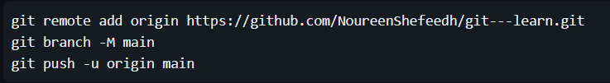
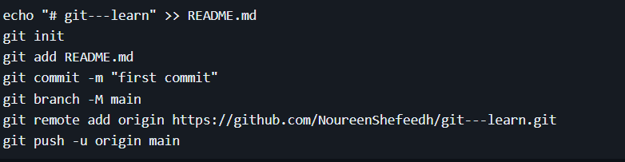
How to push code to remote repository
To push an existing repository
To push a new repository
Note – in https we need to login every time

Slide 6
To setup ssh
ssh-keygen –o ( creates the key)
Where to find the key –
  cd .ssh
  Cat id_rsa.pub (copy the key)
  Paste in github ssh keys
Note –it automatically detects who you are if it has been set up once with a key

Slide 7
Branching
git branch ( to see all branches)
git checkout branch_name ( to go to a certain branch) or git switch ( new version of the same command)
git checkout –b branch_name ( to create a branch) or git switch –c branch_name
git branch –d branch_name ( to delete a branch)
git push origin branch_name ( to push a branch)
git pull origin branch_name ( to pull a branch before merging)

Slide 8
Merge and Rebase
git merge branch name ( to merger we need to be in the main branch)
git merge –abort ( to stop the merge when conflict occurs)
git rebase branch_name
git clone url ( to create a copy of the remote repository on the local machine)
Git remote rm origin ( to remove the repository)
git push origin –delete branch_name (

Slide 9
THANK YOU

